Slide 1

Overview of Tandem

Slide 2
History of Tandem Computers
Founded in 1974
NonStop I finished in 1975
NonStop II released in 1981
Acquired by Compaq in 1997
In 1999, it was determined that Tandem NonStop runs
90% of the world’s securities trades
80% of the world’s ATMs
66% credit card transactions
Compaq acquired by Hewlett-Packard in 2002

Slide 3
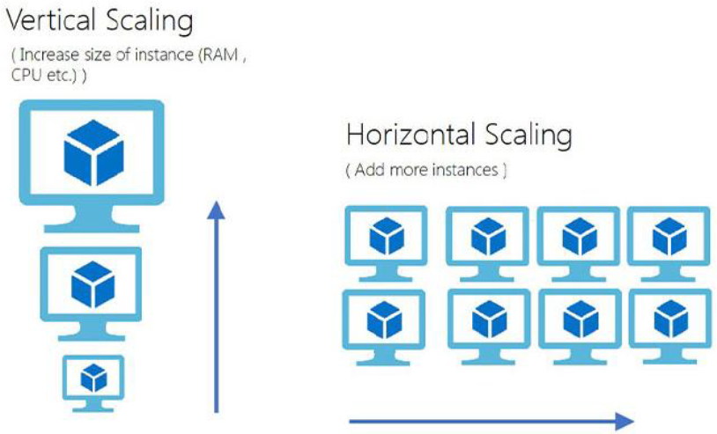
Tandem NonStop
Continuous Availability
Unlimited Scalability
Data Integrity
Notes:
Continuous Availability – minimal down time and fault tolerance in case of errors.
Unlimited Scalability – ability to add more units/power to account for increasing demand and usage. Since nothing is shared, can just keep adding more processors without the fear of being limited by the speed/performance of some shared memory, bus, or switch
Horizontal Scaling – adding more/taking away units to accomodate demand (much more preferred)
Vertical Scaling – increasing/decreasing the power of a particular unit to accommodate demand
Data Integrity – Ensuring data isn’t corrupted, falsified, lost
Why are these traits important in a financial system?

Slide 4
How are these Features Achieved?
Redundancy
Replication
Loose Coupling
Shared Nothing
Message-Based Architecture
Guardian OS (Nonstop I)
Checkpointing
Notes:
Nonstop systems are comprised of modular components with loose-coupling. The components employ redundancy to ensure that if one component fails, an equivalent component can take its place immediately, minimizing down-time. Each processor does not share resources (such as memory, or storage). Rather, they send messages each other through a reliable medium. The Guardian OS is a custom operating system that allows for message passing and checkpointing for each operation.
Continuous availability – redundancy and replication
Scalability – modularized processors. To scale up, can add more processors
Data Integrity – checkpoints, redundancy, not sharing of memory, back-ups

Slide 5


Nonstop I
Finished in 1975
Process Pairs
Primary
Backup
Notes:
The first computer in the Nonstop line of computers
A primary process would clone itself to a backup. If an error occurred, Guardian reroutes a message from the failing component to a functioning component. Here we see a direct example of replication, redundancy, and a message-based architecture creates a fault-tolerant system with minimal downtime.
Like an actor with an understudy

Slide 6
Later Versions
Nonstop II
Released in 1981
Improvement of speed/memory
NonStop TXP
Released in 1983
Doubled Speed
Quadrupled memory

Slide 7
NonStop Himalaya
FOX – allows NonStop systems to be connected
Himalaya
Finished in 1993
Changed underlying architecture
Peer-to-Peer
¼ downtime of other vendors
Notes:
Along with TXP, FOX a fibre optic bus system was developed which allows NonStop systems to be connected together.
Bus - communication system that transfers data between components inside a computer, or between computers
This paved the way for the Himalaya system whose I/O and inter-CPU busses were based on the new ServerNet system which was a true peer-to-peer network.
Finally, in 2000, it was found that the Himalaya system had 1/4th the downtime of other vendors’ systems

Slide 8
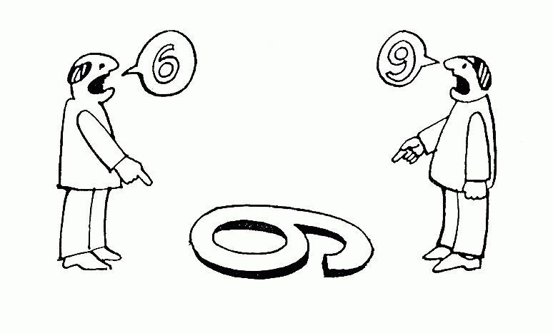
NonStop Today
Self-Checking Processors
Mirroring
Power-Failure Protection
Identical Instruction Streams
Notes:
Self-checking processors – ensures that faults are detected early and that buggy/faulty processors are taken offline so as not to contaminate the rest of the system
Mirroring – replicate disks if one disk drive fails. Server can still operate with the mirrored copy and then return to the original when it is replaced
Using batteries, system can keep running in a power outage, eliminating risk of losing data
Two processors running 2 identical instruction streams so if there is a discrepancy between them, they are shut down immediately to prevent the corrupted data from propogating – like working on homework and you and your friend get different answers

Slide 9
NonStop OS
Message-Based
Includes the Guardian layer
Supported Languages
Java
C
C++
COBOL
SCOBOL
TAL
TACL

Slide 10
TAL – Transaction Application Language
Originally “Tandem Application Language”
CISC – Complex Instruction Set Computer
Syntax like ALGOL or PASCAL
Semantics like C
No indefinite levels of nesting
Does not pass complex arguments by value
Does not strictly type most variable references
Notes:
TAL was the original system programming language for Tandem Computers CISC machines
CISC – an architecture in which single instructions contain several low-level operations like memory loads, arithmetic, and memory stores

Slide 11
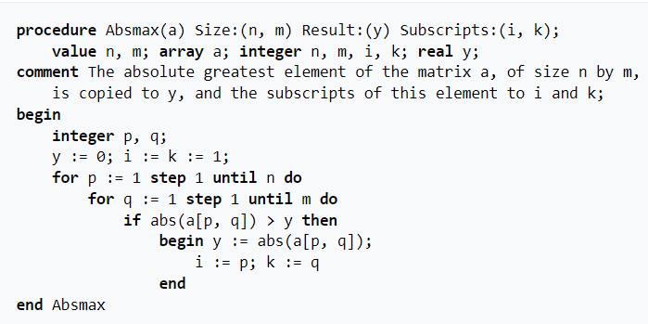
Sample ALGOL Program:

Slide 12
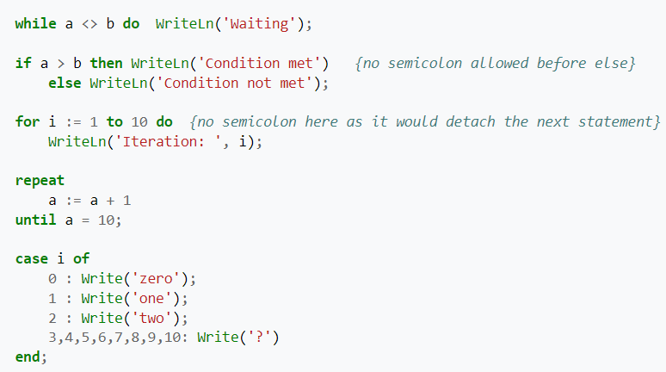
Sample Pascal Program

Slide 13
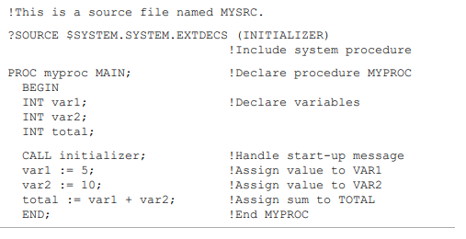
Sample TAL Programs

Slide 14
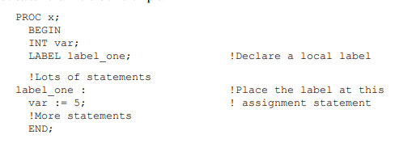
Sample TAL Programs (cont.)

Slide 15
TACL
Tandem Advanced Command Language
Scripting Language
Shell in Tandem/Nonstop computers

Slide 16
Sources Used
https://cs.stanford.edu/people/eroberts/courses/soco/projects/2003-04/fault-tolerant-computing/how-tandem.html
https://en.wikipedia.org/wiki/Tandem_Computers
https://en.wikipedia.org/wiki/Transaction_Application_Language#:~:text=Transaction%20Application%20Language%20or%20TAL,cross%20between%20C%20and%20Pascal.
https://en.wikipedia.org/wiki/ALGOL
https://en.wikipedia.org/wiki/Pascal_(programming_language)
https://en.wikipedia.org/wiki/TACL
https://en.wikipedia.org/wiki/NonStop_(server_computers)
https://en.wikipedia.org/wiki/Shared-nothing_architecture
http://nonstoptools.com/manuals/Tal-Guide.pdf
https://www.hpl.hp.com/techreports/tandem/TR-91.1.pdf

